Slide 1
[Title] (wombo combo doesn’t work as good anymore)
A competitive arena fighter where you have no choice but to count on your teammates!

Slide 2
Narrative
Far in the future, all necessary services have been taken over by robots, and planetary travel has become a custom. With such a convenient society, the humans and aliens have lost track of what they want from life and what their purpose is. As depression spread into the vast galaxy, a sole entrepreneur finds a solution – a way for people to regain their lost motivation and energy. Within each and everyone of us is an mystery yet to be solved. Even those who spends millions of hours together won’t understand the depth of another creature perfectly, but they sure can strive to. This entrepreneur had an idea to create a sport, a battle within an arena where the understanding of your fellow teammates were the only way to achieve victory.
Fight together with your best alien and human friends in an arena in a battle to prove to the world your understanding of each other and get to know eachother better than ever before.

Slide 3
Gameplay
(Flowchart and KEY features)

Slide 4
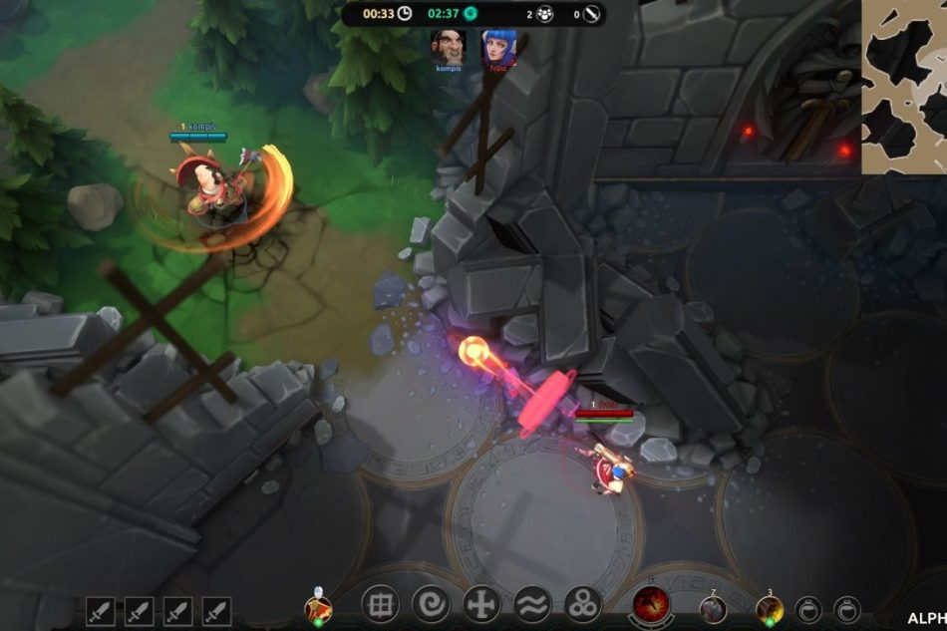
Gameplay
3v3 Arena Fighter
RTS/moba camera, asymmetric
Control a character with unique abilities
Play together with your two teammates to cover up their weaknesses and have them cover your own.
Win by depleting enemy team’s Team Spirit

Slide 5


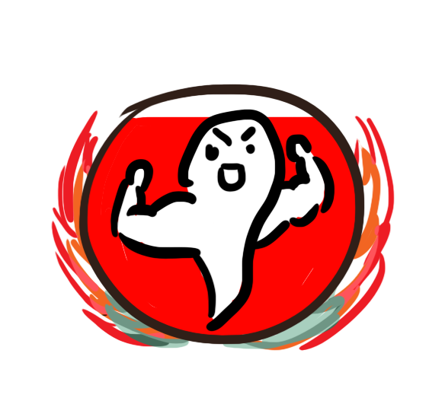
Team Spirit
The health of the game
Win by reducing enemies’ team spirit to 0
You share team spirit with you teammates
Team spirit is gained by:
Hitting and combining skills
Sticking together with your teammates
Team spirit is lost by:
Getting direct hits from enemy smasher
Being apart from teammates

Slide 6
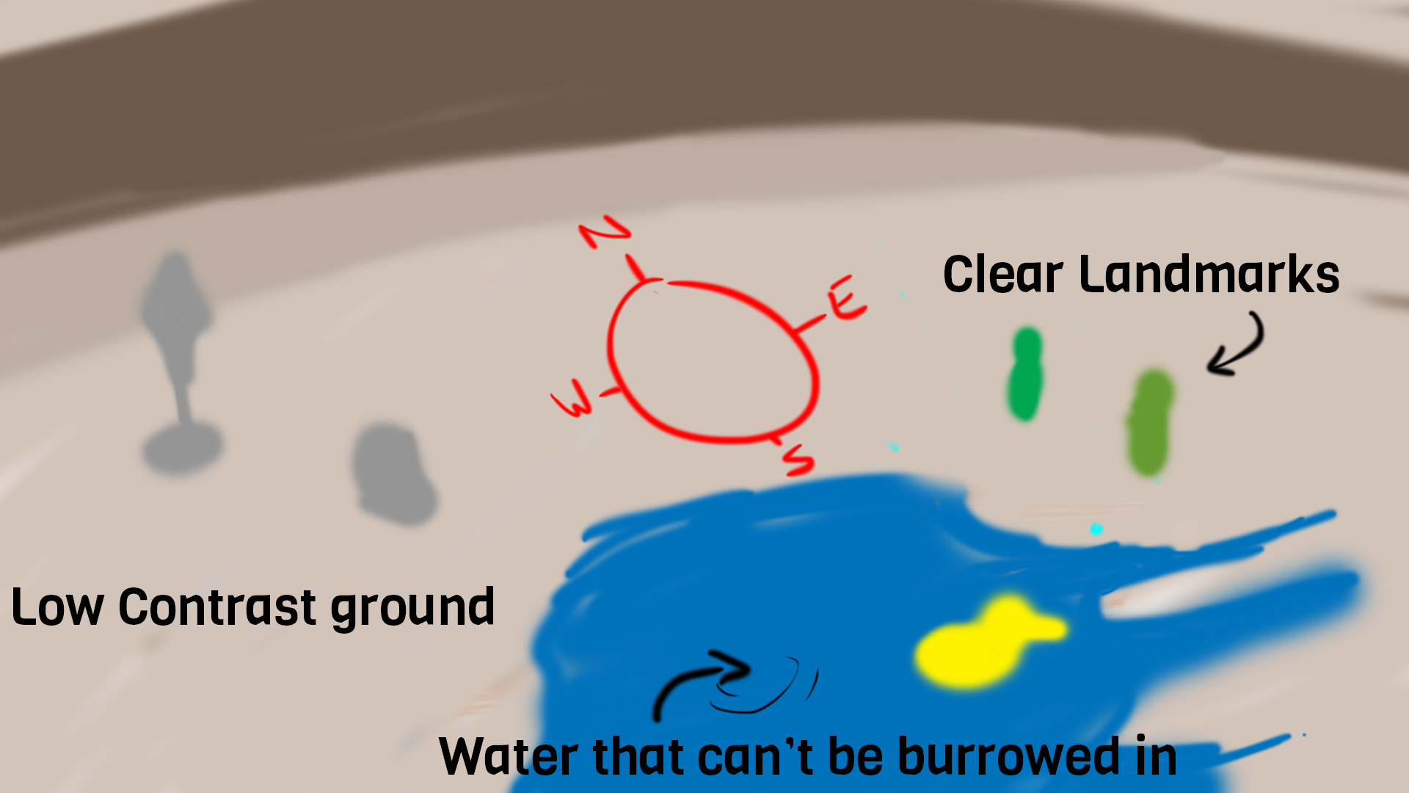
More Gameplay
All characters are invisible unless pinged by Settler or sensed by a burrowed Blocker.
Or low field of vision
Dark
Lost saturation
Fog of war
Less LOD
Or tricky terrain
Or

Slide 7
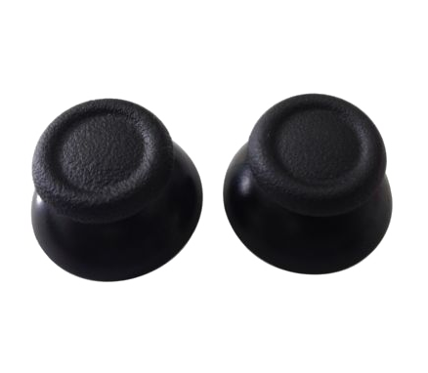
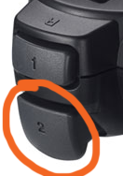
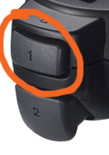

What can I do?
Walk in different speed depending on how far you push the stick left stick
Rotate your character to aim abilities with right stick
Use Primary Ability
Use Secondary Ability
Give your teammates a high five

Slide 8
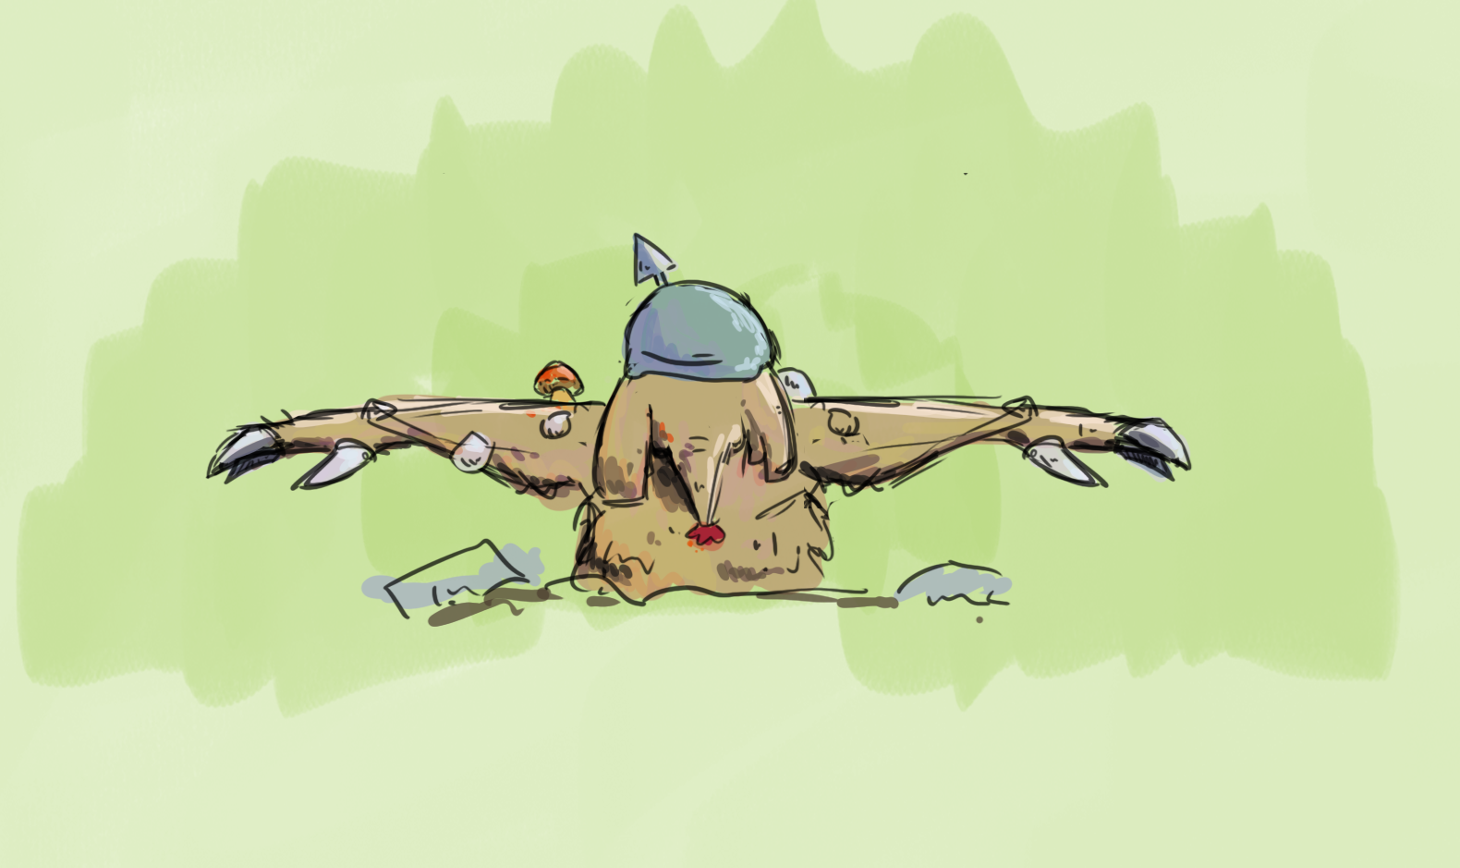
Character 1 - Blocker -
Primary Ability: Digs down to get enemy location through sensing vibrations.
Has an overheating system so he can only stay down for so long before having to come back up to rest.
Secondary Ability: Blocks enemy smash by raising a wall of earth.
Care for not making him too brown. Add some elements of brown

Slide 9

Character 2 - Settler -
Primary Ability: Pings target location to grant the Smasher and Blocker vision over that area
Secondary Ability: Has the ability to drag enemies in an area together into one spot.

Slide 10

Character 3 - Smasher -
Gets warned when pinged by enemy settler.
Primary Ability (Smash): Shoots out an energy orb in target direction. By pressing the ability button again the orb will explode and reduce team spirit based on amount of targets hit.
Secondary Ability:

Slide 11
Blocker
Settler
Smasher
Can see enemies
Can’t see pinged enemies
Can’t tell if the team is pinged
Can’t see enemy attack
Can’t see enemies
Can ping enemies
Can’t tell if the team is pinged
Sees enemy attack if close
Can’t see enemies
Can see pinged enemies
Can tell if the team is pinged
Sees enemy attack from afar

Slide 12
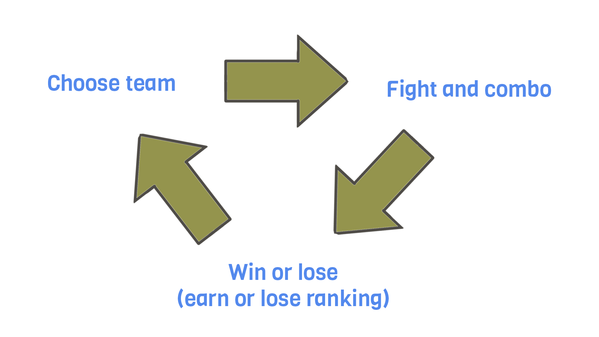
Flowcharts
Team that finds enemies first ▼
Blocker burrows to find enemies ► Calls their location to Settler ► Settler pings enemies ► Smasher sees enemies ► Settler calls where in that visible area he’s going to pull them to ► Smasher tries to hit his
Hopefully results in a direct hit.
Team that gets found
▼
Smasher calls out that they have been spotted ► Blocker getting closer to teammates ► Smasher calls from where the enemy SMASH is coming from ► Settler makes a guess to ping where the enemies are ► Blocker puts up shield in that direction.
Hopefully results in a block.

Slide 13
UI Navigation

Slide 14
Technicalities
And things I find boring

Slide 15
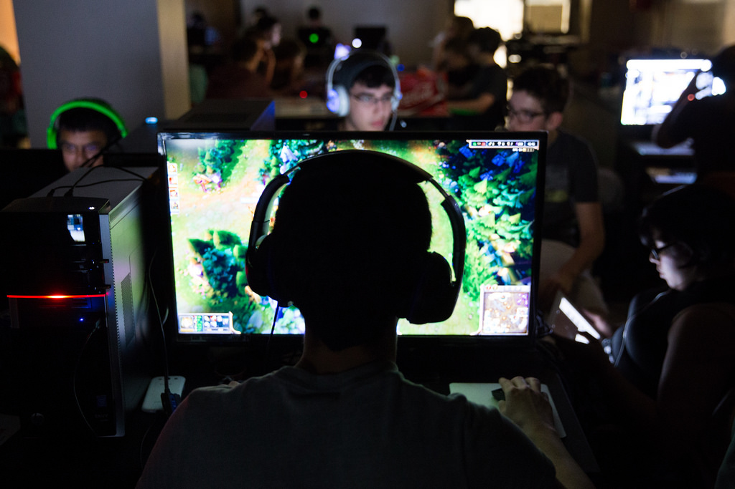
Audience
People that play mobas with friends but want a better way of expressing their teamwork than the long downtime fights that focus more on individual play rather than teamwork.
People that enjoy sports and the competitive feeling of team vs team.
PROBLEM: Mobas are not normally controller played games. Target audience might not have required hardware.
SOLUTION: Switch to keyboard and mouse for input?

Slide 16
Hardware
PC – Best played with controller????
^that’s just a bad idea, right?

Slide 17
Software
Game Engine: Unity or Unreal, whichever is better for networking.
Code: Visual Studio
Art: Substance Painter, Photoshop, 3DS Max, Motionbuilder
Others: Audacity, Vegas Pro (For trailers), OBS Studio (For recording gameplay)

Slide 18
Idea workshop
Feedback for moving apart, change in movement.
1p?
Just movement, make movement within the team spirit area of affection interesting/fun
Terrain/arena
Properties
layout
Shape
Theme
Reduced vision
Hurdles
Team spirit = Dependant on all characters
Talk to Jerry or Tommy Liponen
Networking
Multiplayer
Teamspirit distance reduction. Picture. Feedback.
Mechanics that are available when only close.
What happens after a smash has been shot?
Round system: 1. find each other 2. strategy 3. fight
1. Find -> Fighting

Slide 19
Ántingen gör en Über med allas abilities combinade. Eller simplifiera alla karaktärer och gör allting helt klart.
MVP är en Über delad upp på tre spelare och en environment att ta sig igenom. Team spirit som är logisk även mött med byggd environment utan att ha ett enemy team att tänka på.
Proplist environment. Med animationer o.s.v.
Hur kommunicerar man utan text? Ljud, tecken, symboler, färger, monster, animationer, etc.
Semiotik m. Johan, Mika.
Hur ser en environment ut för varje individual spelare?
MDA
Mail Johan, Tommy...

